Slide 1



Metamorphic Testing and Debugging of Tax Preparation Software
Saeid Tizpaz-Niari
Computer Science Department
University of Texas at El Paso
Verya Monjezi
Computer Science Department
University of Texas at El Paso
Morgan Wagner
Psychology Department
University of Texas at El Paso
Shiva Darian
Information Science Department
University of Colorado Boulder
Krystia Reed
Psychology Department
University of Texas at El Paso
Ashutosh Trivedi
Computer Science Department
University of Colorado Boulder
Notes:
Hello everyone, this is Saeid Tizpaz-Niari from UTEP. I present Metamorphic … This is joint work between computer science researchers and legal psychologists from both UT El Paso and CU Boulder

Slide 2
“ Our new Constitution is now established, and has an appearance that promises permanency; but in this world nothing can be said to be certain, except death and taxes.”
— Benjamin Franklin, in a letter to Jean-Baptiste Le Roy, 1789
Notes:
I would like to start my talk with a famous quote from Benjamin Franklin who said in this world nothing can be said to be certain except death and taxes!
Of course, I do not like to talk about the death, so let us talk about the taxes!

Slide 3
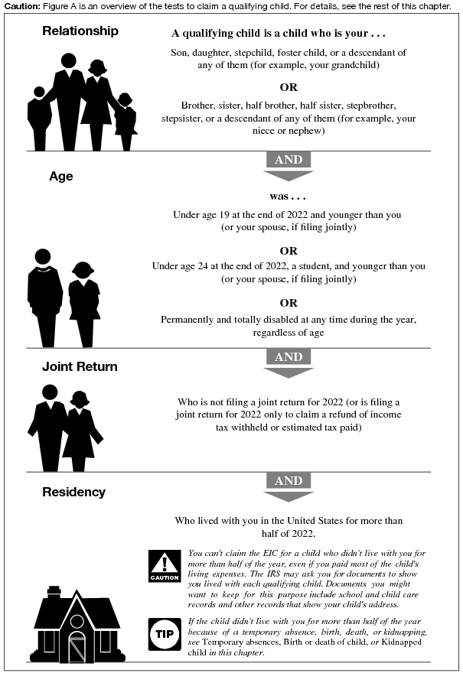
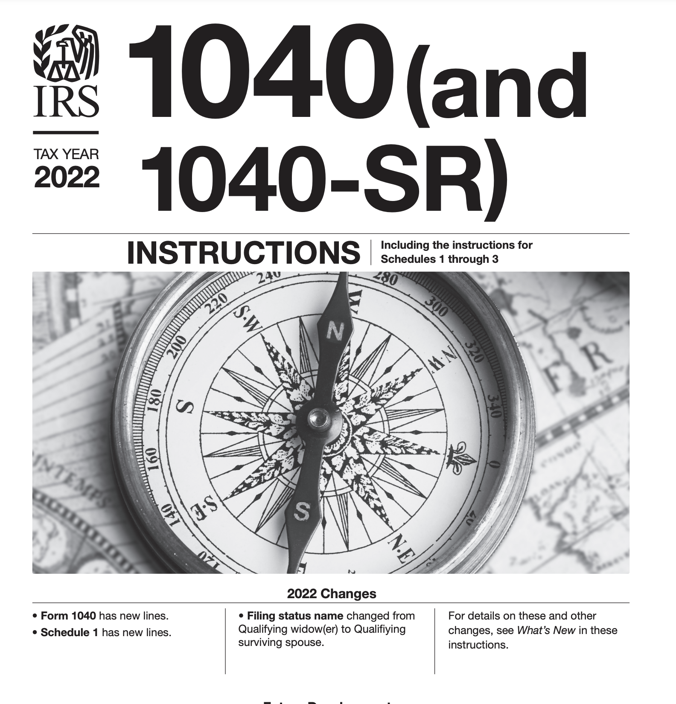
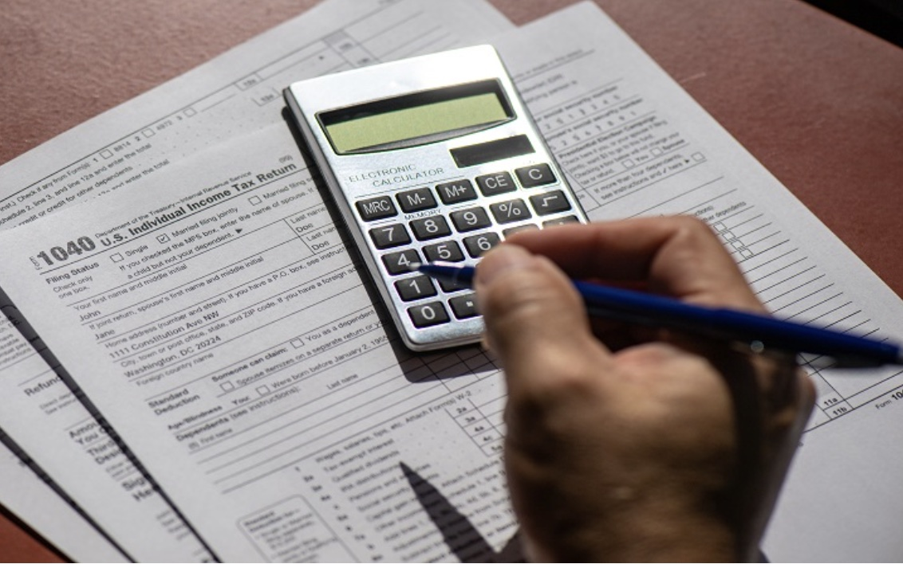
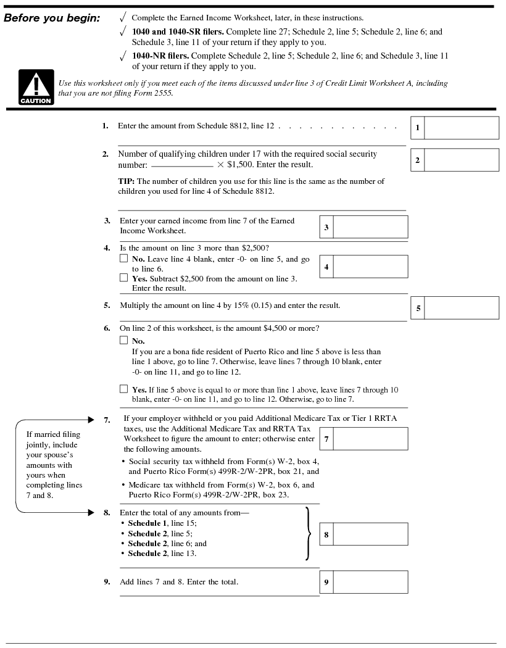
U.S. Tax 101: Manual Tax Filling
Publication 596 (EITC)
Schedule
8812
Notes:
You grab a calculator, you print out bunch of forms like 1040 which is for individual tax return and you try to figure out different fields, etc in the form.
Soon you realize that you need to go and read the instruction forms for 1040, and in doing so, you might need to go to various publications such as publication 596 for EITC, …
If you did not give up, congratulation, you are ready to file your taxes.

Slide 4

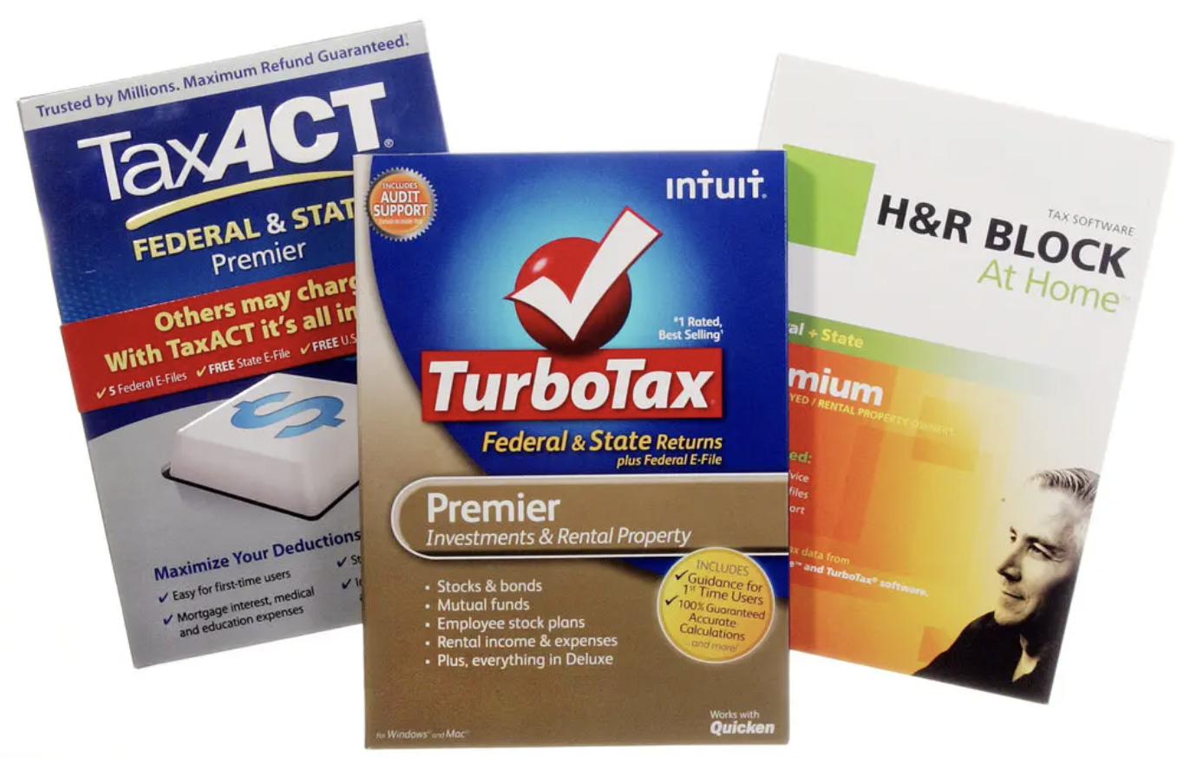
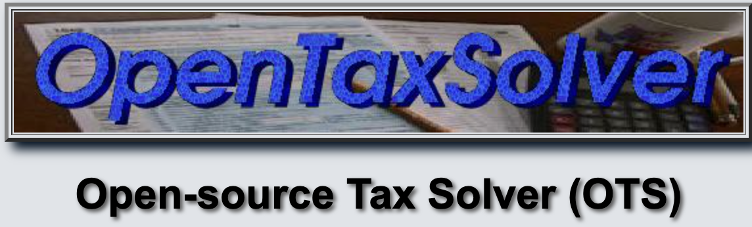
Tax Preparation Software (US-based)
72 million tax returns via software
11.2 billion dollars industry
Free (Open-source) options for low-income
Notes:
But unfortunately, many individuals give up and turn to tax prep. software to assist them in filing taxes.
In 2020, over 72 million people prepared their taxes without the help of tax professionals, a 24 percent increase from 2019.
Even though there are some freely available open-source alternatives: we really like open-source, but in this domain, such software is less regulated and has not gone through rigorous process.

Slide 5
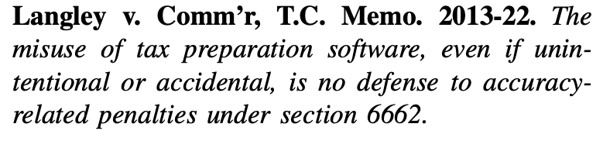
Notes:
Tax Software is an AS-IS Software Solution

Slide 6
Accountable Tax Software
Comply with laws, regulations, or public policies as they evolve over time.
Approaches for Accountability of Software
Formal verification to ensure compliance;
Methodologies for software design, development, and maintenance; and
Specification and reasoning about software compliance and accountability.
See solicitation for Designing Accountable Software Systems (DASS): https://www.nsf.gov/pubs/2022/nsf22512/nsf22512.htm
Notes:
Having an obligation or responsibility for compliance with law, regulation, or public policy, or its intent or operation
Regulation¹ is defined as “a rule of order having the force of law, prescribed by a superior or competent authority, relating to the actions of those under the authority’s control.” Well-known examples include the European Union General Data Protection Regulation (GDPR) and the California Consumer Privacy Act (CCPA), which require more transparency in how consumer data are collected, shared, and used. Such regulations are meant to hold organizations and individuals accountable, and software designed to implement such laws, regulations, or policies must be accountable as well.

Slide 7
Challenges
Absence of Oracle
Given a taxpayer profile, the ground truth for the tax returns, eligibilities, and credits are not known a prior even for the tax experts;
Lack of Trustworthy Dataset
Due to obvious privacy and legal concerns; and
Computationally difficult
Finding similar tax profiles is hard (scale, notion of similarity, etc).

Slide 8
Differential Debugging of Tax Software
Observation 1:
Tax law adheres to the principles of ``common’’ law;
It implements the legal doctrine of precedent; hence,
Similar cases must follow similar rulings.
Observation 2:
Horizontal equity in taxation: relation between similarly situated tax-payers;
Vertical equity in taxation: relation between taxpayers in different income buckets
Notes:
Since the US tax law is a law code, adheres to principle of common law and implements stare decisis, i.e. the legal doctrine of precedent: similar cases must follow similar rulings.

Slide 9
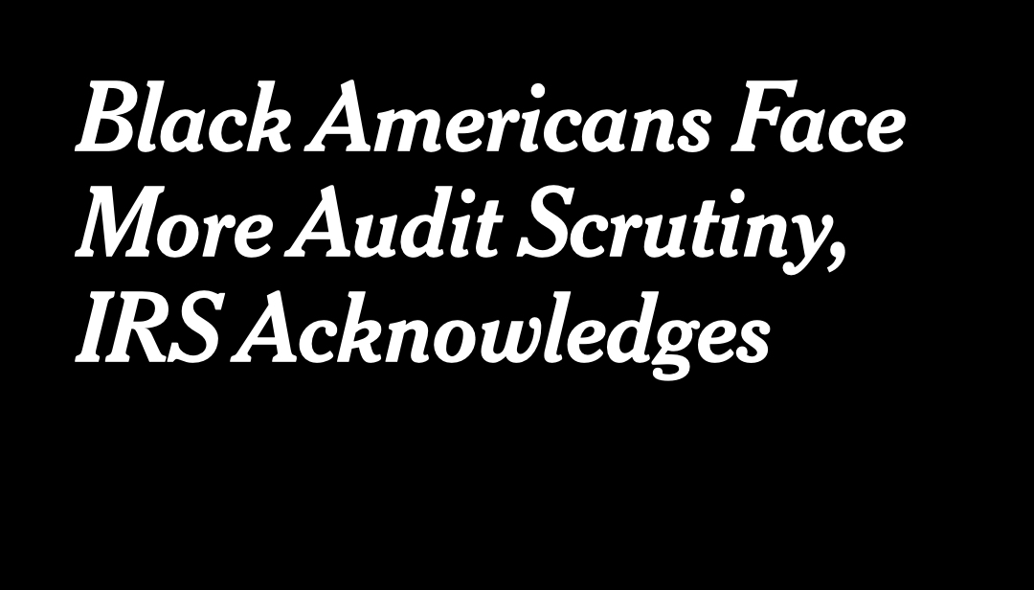
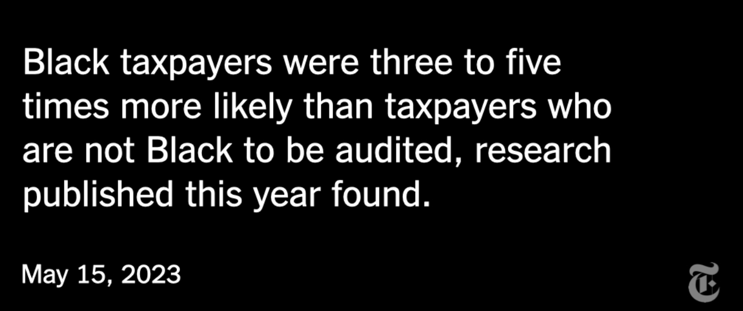
Equity in Tax Domain Goes Beyond Software
Racial Bias in IRS Tax Audits

Slide 10
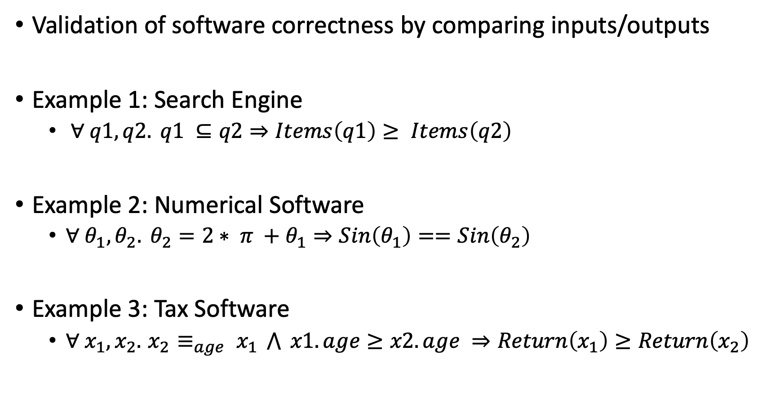
Metamorphic Specifications
Validation of software correctness by comparing inputs/outputs
Example 1: Search Engine
$∀ q1, q2. q1 ⊆q2⇒Items\left(q1\right)≥ Items\left(q2\right)$
Example 2: Numerical Software
$∀ θ_{1},θ_{2}. θ_{2}=2∗ π +θ_{1}⇒Sin\left(θ_{1}\right)==Sin\left(θ_{2}\right)$
Example 3: Tax Software
$∀ x_{1},x_{2}. { x}_{2} ≡_{age} x_{1} \bigwedge{ x1.age≥x2.age} ⇒Return\left(x_{1}\right)≥Return\left(x_{2}\right)$

Slide 11
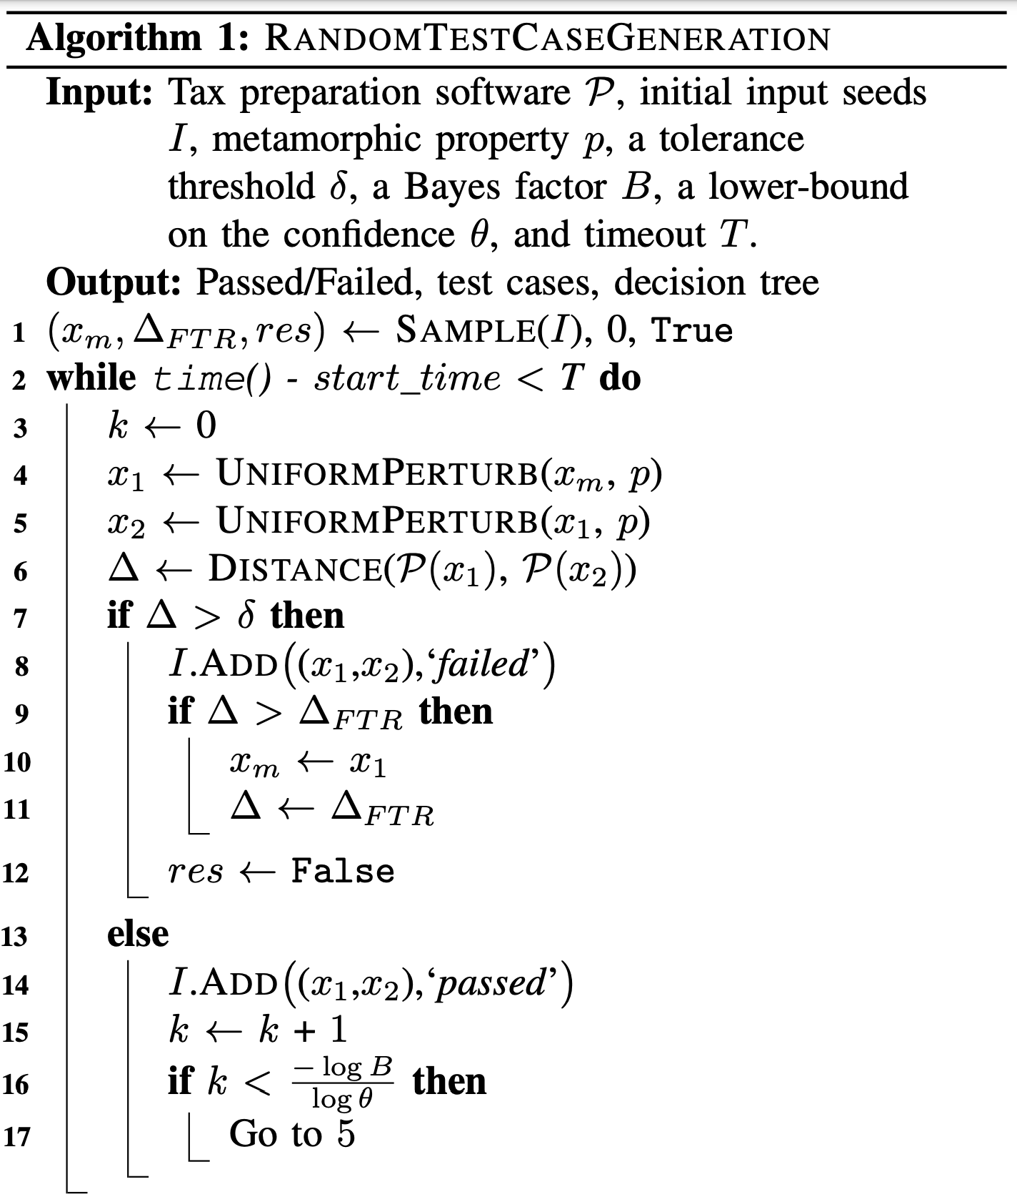
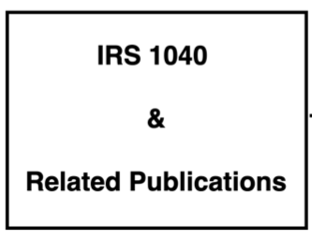
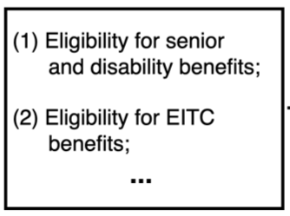
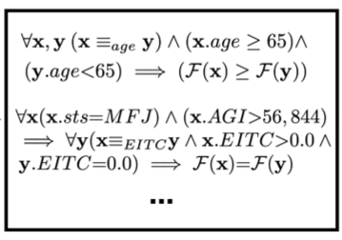
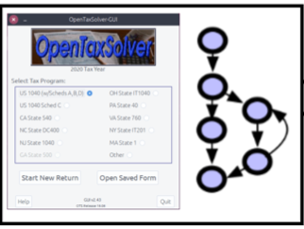
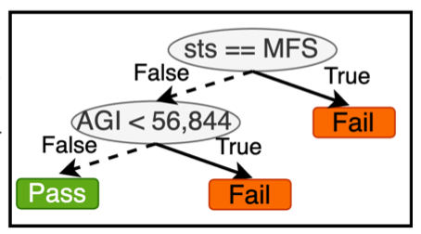
TenForty
Metamorphic
Specification
Search for
Finding Bugs
Data-Driven
Fault Localization
Tax Law and Policy
Scenarios

Slide 12
Research Questions
RQ1: Are metamorphic relation (MR) useful to capture the legal requirements of tax preparation software?
RQ2: Can randomized algorithm with Bayesian guarantees be effective in testing tax preparation software against the MR?
RQ3: Could data-driven fault localization help pinpoint the root of failures in the internal and input spaces?

Slide 13
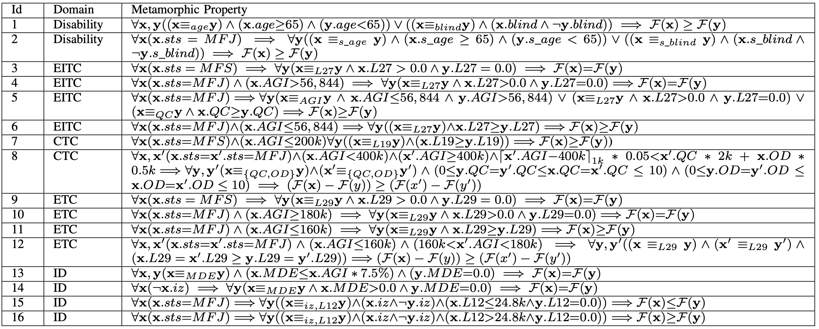
RQ1: Suitability of MR for Tax Law and Policy

Slide 14
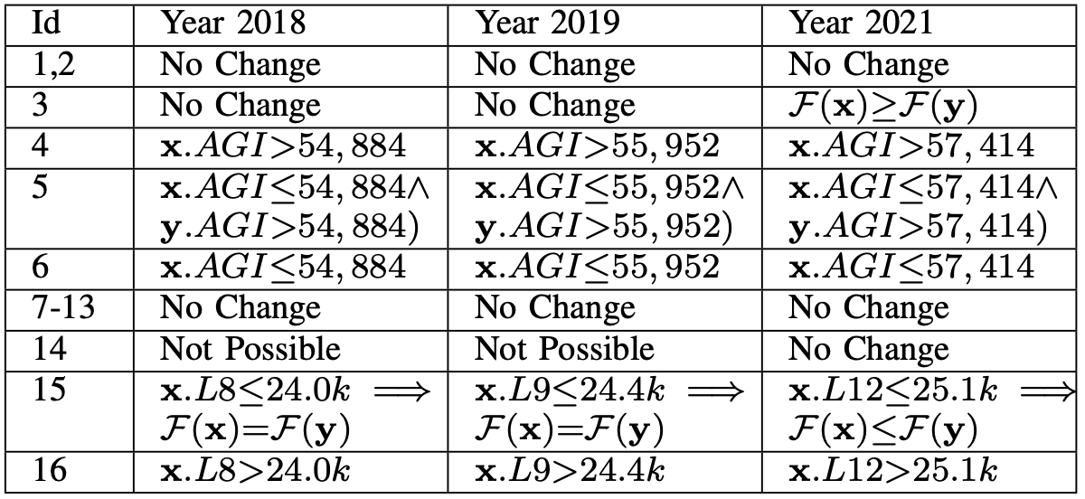
RQ1: Suitability of MR for Tax Law and Policy
Answer RQ1:
Metamorphic relations are suitable to specify the correctness requirements in tax software.
These relations allow us to update the requirements as the tax policies evolve over time.

Slide 15
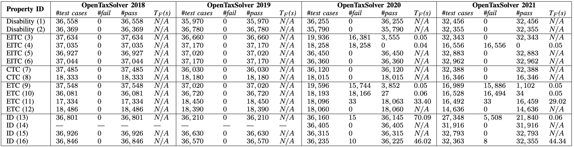
RQ2: Testing Software against MR requirements
Answer RQ2:
Updated software is no longer satisfying the correctness requirements.
Multiple weakness areas relate to married filing separately status.
Notes:
common law marriage

Slide 16
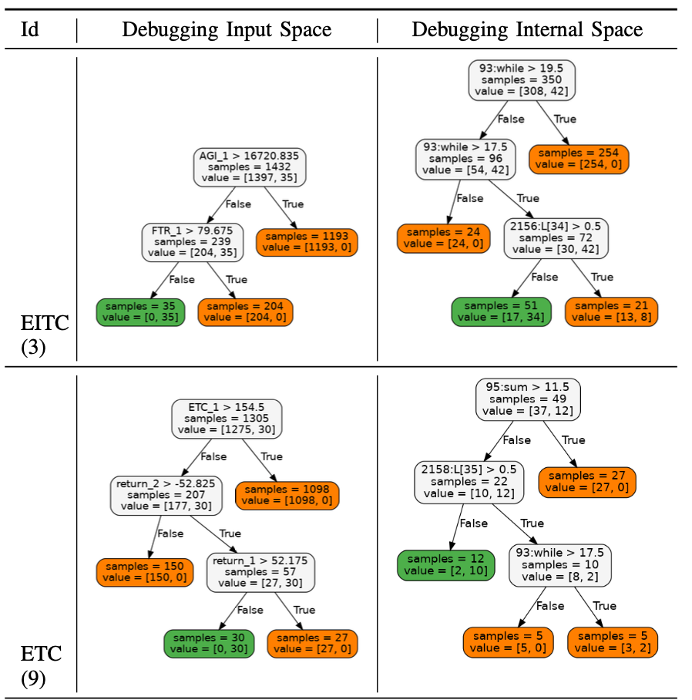
RQ3: Data-Driven Root Cause Identification
Answer RQ3:
Decision trees are useful artifacts to explain failing circumstances.
Our experiences show that the software might completely miss an eligibility condition.
Our results also showed unexpected errors due to finite precision in the computation.

Slide 17
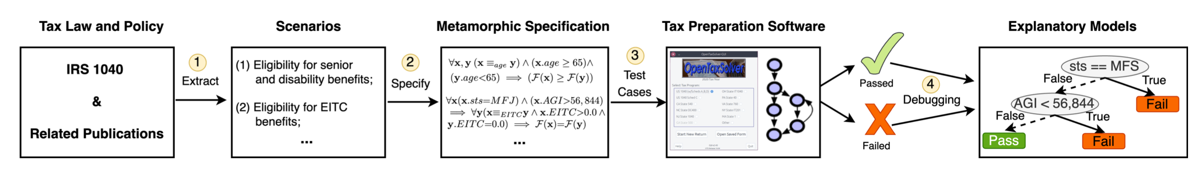
Metamorphic Testing and Debugging of Tax Preparation Software (https://arxiv.org/abs/2205.04998)
Forensic DNA Software
New York City's Office of Chief Medical Examiner (OCME) for thousands of criminal cases between 2011 and 2017
Undisclosed data dropping method CheckFrequencyForRemoval()
Falsely skew results toward false inclusion for individuals whose DNA was not present.
“Do I Qualify?” Screening Software
Poverty management systems in Pennsylvania (Check Eligibility)
Comparative implementation of benefit eligibility handbook
Errors in the eligibility checking: Exclude the most vulnerable families from receiving the essential aids

